Slide 1
Guy Fawkes’ Day and Bonfire Night
9G Rotaru Mihnea,Vila Andrei,Mitroi Aida,Voicu Mihai

Slide 2
Setting for the stage
In the Uk,Guy Fawkes’ Day,also referred to as Bonfire Night,is an annual commemoration of a failed assasination attempt of King James I.
It all started in 1606 when a group of English Catholics tried to kill the king by blowing up the parliament.But why you may ask?Well you see…the king was protestant,and we all know catholics and protestants don’t like each other a lot.Yes.This whole thing,including this presentation,was started by a dispute over whose interpretation of the same god was more accurate.It may seem like just a childish argument,but you have to understand that it had only been a few years since Henry the Eight cut ties with the catholic church(because the pope denied Henry from divorcing his wife) and declared England a protestant nation.That is when british euroscepticism(basically,the reason brexit is a thing) of a largely catholic european continent gained sprout.The entire situation became even more polarizing when King James I publicly condemned all Catholics.Come on,they wont kill each other over it?Yes.Yes they will.

Slide 3
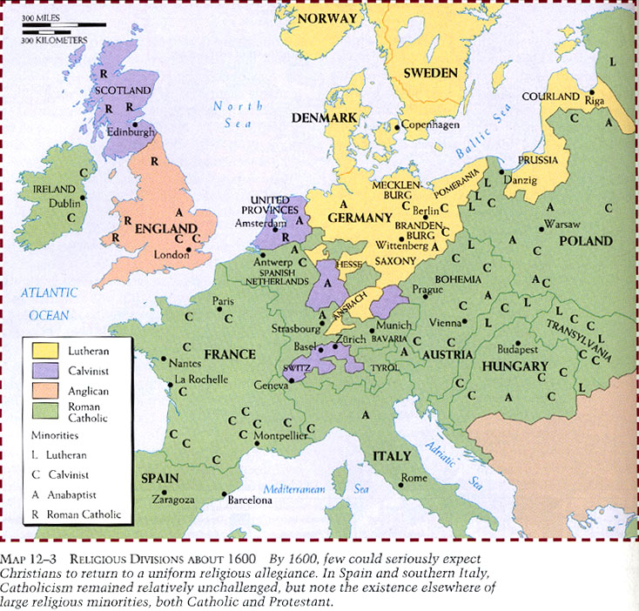

Slide 4
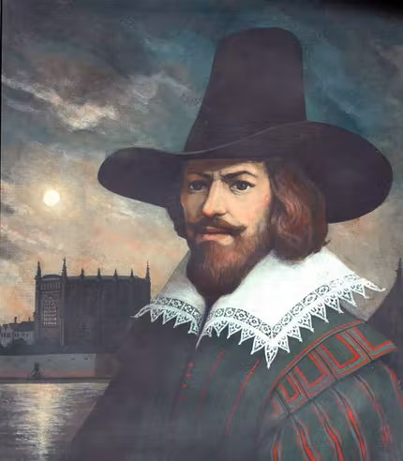
So here enters Guy Fawkes.
So here enters Guy Fawkes,a man who disliked protestants so much,he went all the way to Spain to fight them.A man so clever,he thought John Johnson was a believable alias(which he used as a caretaker of a dungeon where he and his group of radicals would stockpile gunpowder which they would blow up on the 5th of November during the opening of a new session of parliament).
Funny enough the real mastermind of the plan was Robert Catsbey who,compared to Guy Fawkes,almost nobody recognizes him.He is just the guy who was arrested over the plot.It should be called Robert Catsbey Night

Slide 5
A well concocted plan,but…
It might have actually gone well had it not been for an anonymous letter that advised a catholic sympathizer to avoid the session,which raised a lot of suspicion.This led to the intervention of a search party which found Guy Fawkes just casually sitting next to 36 barrels full of gunpowder with some matchsticks in his pocket.He had one job,not 3,not 2,1 job.
He was immediately arrested.Don’t you just hate it?You feel like everything is going great until the most random thing happens and screws it all up!When the public heard the news,people started lighting up bonfires(event which took place during the night,so we have bonfire night).If Guy Fawkes wasn’t going to burn down London,the citizens surely would.In the business we call it a contingency plan.

Slide 6
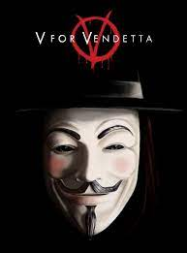
Back to the present
So every year on the 5th of November,British people celebrate Bonfire Night.A common tradition is to throw a straw dummy in fire,the straw dummy representing Guy Fawkes and his treason. An interesting fact is that in some piece of media like”V is for Vendetta”,Fawkes is portrayed as a revolutionary hero and the protagonist wears a Guy Fawkes mask.”He was just trying to set England on what he deemed the right path”.
Honestly,this is just a hilarious back fire.Imagine failing or screwing up so terribly,people celebrate it every year.Imagine failing your math test so hard,every month your teacher brings cake to the classroom and gives everyone a slice,except for you!
Image of a Guy Fawkes “Anonymous” Mask

